Slide 1



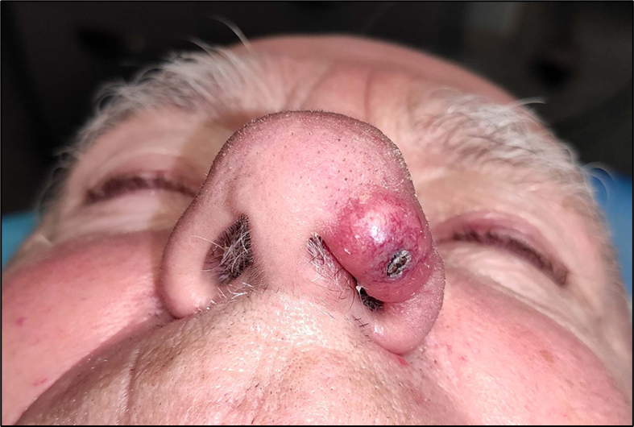
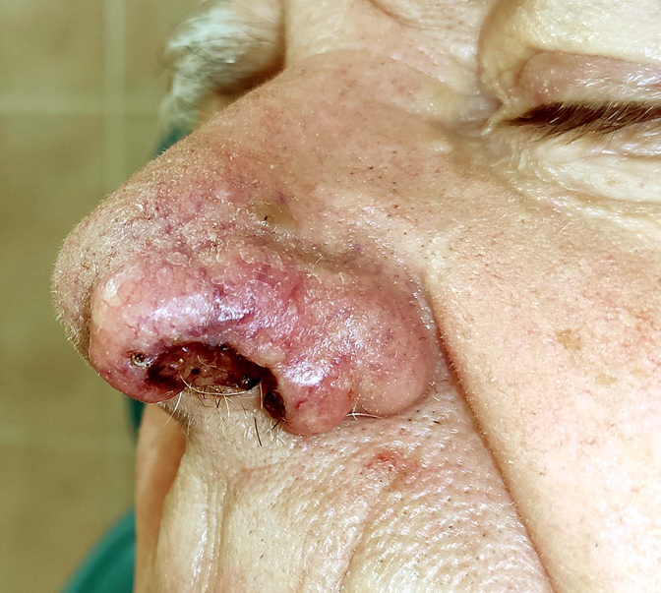
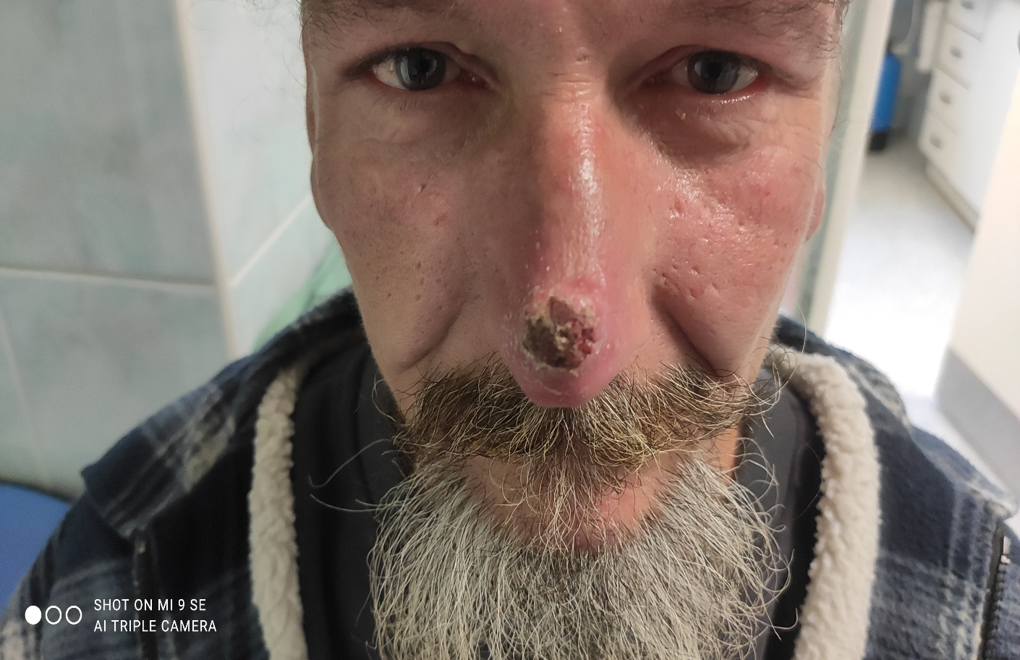
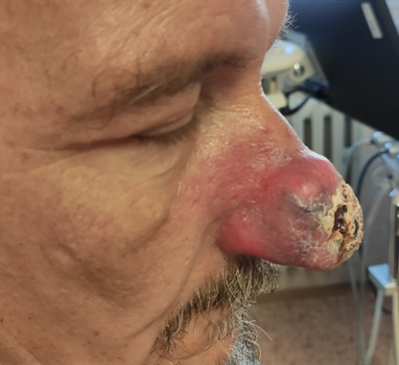
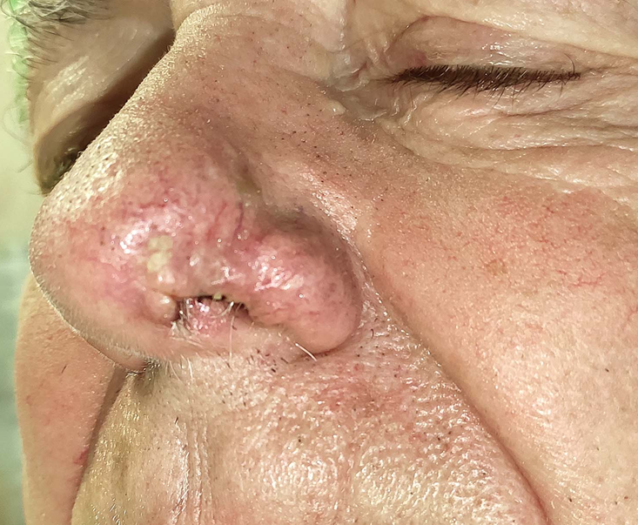
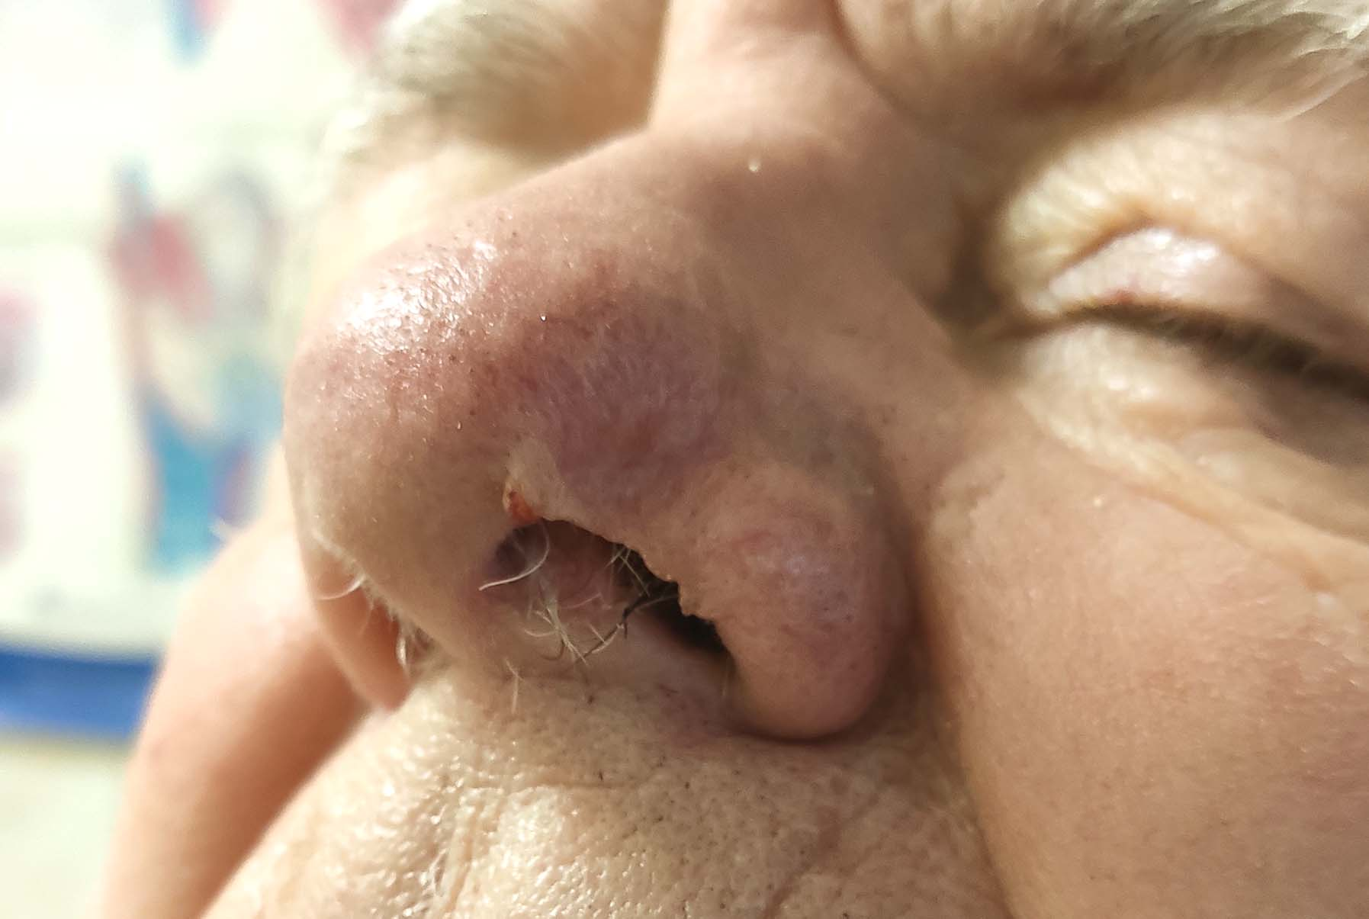
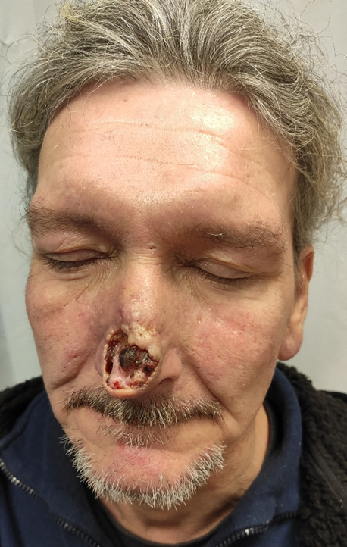
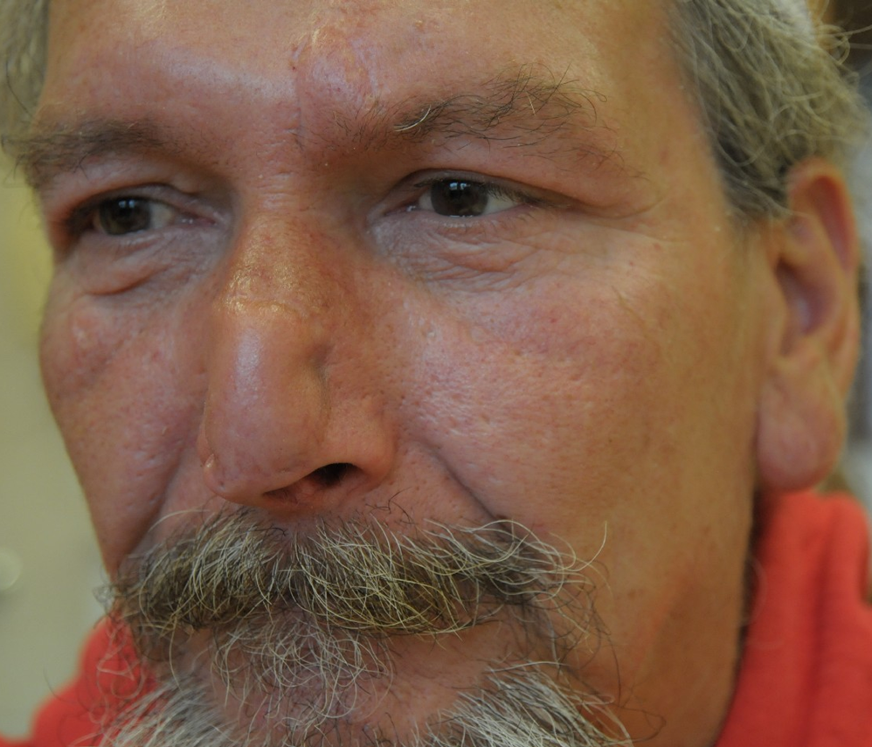
Keratoacanthoma of the Nose: A Diagnostic and Therapeutic Challenge – Two Case Reports
Golovach P.¹, Sakař R.¹, Pizinger K.², Slouka D.
¹Department¹ Department of Otorhinolaryngology and Head and Neck Surgery, Faculty of Medicine in Pilsen, Charles University, University Hospital Pilsen, Pilsen, Czech Republic
² Department of Dermatovenereology, Faculty of Medicine in Pilsen, Charles University, University Hospital Pilsen, Pilsen, Czech Republic
Background
Keratoacanthoma is a distinctive epidermal tumor of unknown etiology, with an incidence of 100–150 per 100,000 patients, occurring twice as frequently in men and predominantly in the 6th–8th decades of life.
Its characteristic clinical course consists of three phases:
1. rapid growth (3–5 weeks), 2. latent phase, 3. regression/involution.
Macroscopically, it presents as a hemispherical tumor with raised, rolled borders and a central keratin-filled crater.
Histologically, it can be difficult to distinguish from squamous cell carcinoma.
Treatment is individualized and primarily involves surgical excision; however, in selected cases, conservative management such as watchful waiting or intralesional therapy may be considered.
These case reports highlight the importance of careful clinical assessment and interdisciplinary collaboration when determining the optimal therapeutic approach.
Case 1
Case 2
80-year-old man with a 1-month history of a rapidly growing lesion on the left nasal ala
At the initial ENT assessment, an atheroma was suspected→ incision and treatment with topical antibiotic ointment.
Diagnostic biopsy revealed squamous cell carcinoma.
Neck ultrasound showed no regional lymph node metastases; surgical excision was planned.
During further evaluation, the lesion began to spontaneously regress → Raising suspicion of keratoacanthoma
Watchful waiting was chosen.
After 6 months, there was near-complete regression with minimal scarring.
56-year-old man referred by a dermatologist for consideration of excision of a tumor of the nasal apex
Based on the medical history and clinical appearance, keratoacanthoma was suspected → surgery was deferred.
Conservative management with intralesional methotrexate and close follow-up was initiated.
Within 2 weeks, the lesion continued to progress, reaching approximately 6 cm in diameter.
Subsequent spontaneous regression and gradual healing of the lesion occurred.
Significant residual nasal deformity remained → plastic reconstructive surgery was indicated.
Initial presentation
2 months after initiation of treatment
Initial presentation
2 weeks after initiation of treatment
3 months after initiation of treatment
6 months after initiation of treatment
1 month after initiation of treatment
Patient after plastic reconstructive surgery
DIAGNOSTIC CHALLENGES
In both patients, squamous cell carcinoma was initially suspected, with radical surgical treatment planned and a potential risk of significant cosmetic deformity.
However, the dynamic growth pattern followed by regression provided a key diagnostic clue, allowing a more conservative therapeutic approach and avoidance of primarily radical surgery.
CONCLUSION
Email: golovachp@fnplzen.cz
Grant support: This work was supported within the Cooperatio Programme, SURG research area.
Supported by the Ministry of Health of the Czech Republic – RVO (FNPl, 00669806).
Keratoacanthoma represents a diagnostically challenging entity that may significantly influence therapeutic decision-making, particularly in cosmetically sensitive anatomical locations.
An individualized, interdisciplinary approach, based on careful clinical assessment and evaluation of the lesion’s dynamic course, is essential for selecting the most appropriate treatment strategy

