Slide 1



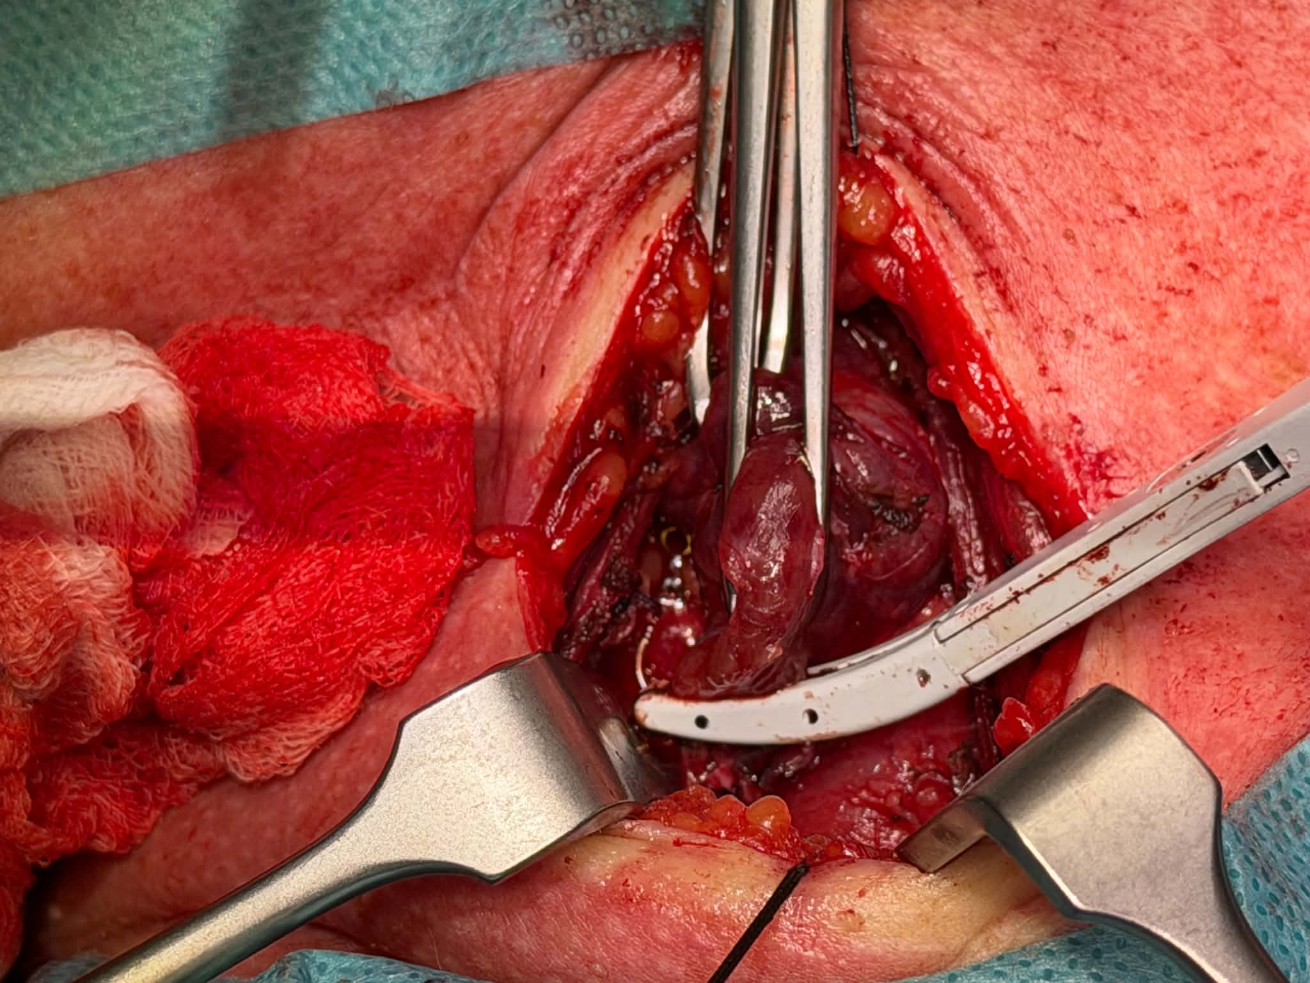

Use of Ligasure sealing system in Total thyroidectomy and its effect on surgery length
MUDr. Anežka Jakubcová, prim. MUDr. Radek Langer, Oblastní nemocnice Mladá Boleslav
AIM OF THE WORK
To assess whether the use of LigaSure reduces operating time during standard total thyroidectomy compared with traditional hemostatic techniques
The LigaSure™ sealing system is a bipolar electrosurgical vessel-sealing technology that uses high current and low voltage to achieve a consistent seal of vessels up to 7 mm in diameter, with limited lateral thermal spread.
The system incorporates tissue-sensing technology that allows the generator to adjust energy delivery according to the characteristics of the tissue between the instrument jaws, providing a reliable permanent seal.
LigaSure has been routinely used in our ENT department since January 2016.
MATERIALS AND METHODS
We retrospectively analyzed 741 standard total thyroidectomies performed at our department between January 2003 and January 2023.
Patients were divided according to the method of intraoperative hemostasis:
LigaSure group: 220 patients Traditional hemostasis group: 521 patients
To ensure comparability, we included standard total thyroidectomies only. Procedures involving collar mediastinotomy, lymph-node dissection/resection, or other additional surgical procedures were excluded.
In our group there were 636 women and 105 men, which matches with higher prevalence of thyroid dysfunction in women in general population.
RESULTS
A total of 741 standard total thyroidectomies were analyzed. The mean operating time was 80.83 minutes in the LigaSure group and 105.65 minutes in the non-LigaSure group, representing an absolute difference of 24.81 minutes and a relative difference of approximately 23.5%. The median operating time was 78.5 minutes with LigaSure and 104 minutes without LigaSure. According to our data both the mean and median operating times were lower in procedures performed using the LigaSure sealing system.In the analyzed dataset, the most frequent indications for total thyroidectomy were nontoxic multinodular goiter (n = 320) and thyrotoxicosis (n = 259). In patients with nontoxic multinodular goiter, the difference in operating time between the LigaSure and non-LigaSure groups was consistent with the overall findings. A greater difference in operating time was observed in the thyrotoxicosis subgroup. In these patients, the mean operating time was 81.16 minutes with LigaSure compared with 113.19 minutes without LigaSure, while the corresponding median operating times were 76 minutes and 110 minutes, respectively. The difference in operating time between the two techniques was more pronounced among patients undergoing total thyroidectomy for thyrotoxicosis.
CONCLUSION
The use of the LigaSure sealing system was associated with shorter operating times in standard total thyroidectomy compared with traditional hemostatic techniques. The difference was also observed in the two most common diagnostic subgroups, with a more pronounced difference among patients with thyrotoxicosis. LigaSure provided an effective method of intraoperative hemostasis and has become a standard tool for total thyroidectomy and ohter procedures in our department. Further analysis of postoperative complications and patient outcomes is warranted to assess the broader impact of its use.
Email: jak.anezka@gmail.com
Grant support:

